Slide 2
Objectives
Describe the processes involved in, and the aim of carrying out, a range of cyber security threats including:
Brute-force attack
Data interception
Distributed denial of service (DDoS) attack
Hacking
Malware (virus, worm, Trojan horse, spyware, adware, ransomware)
Pharming
Phishing and social engineering

Slide 3
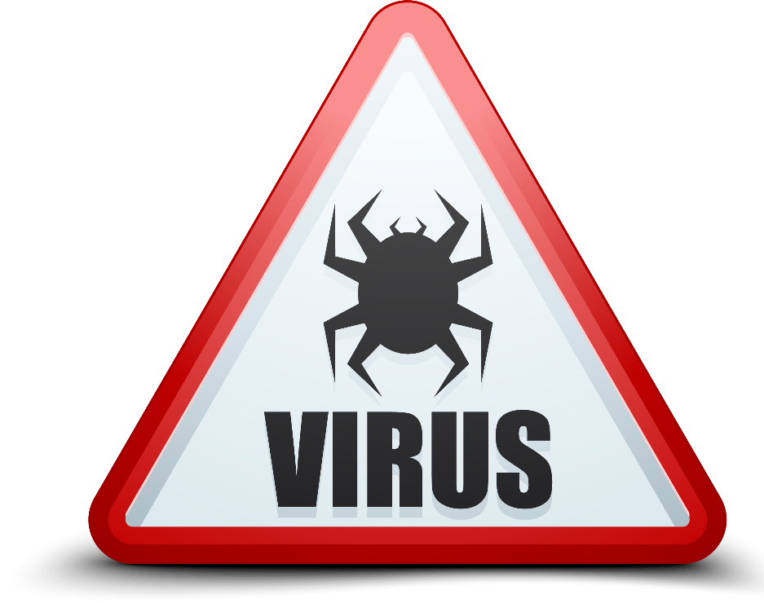
Starter
List at least three types of software that are made to harm a computer
How are these types of software prevented from carrying out harm?

Slide 4
Starter
Harmful software includes:
Malware (viruses, worms, Trojan horses, spyware, adware and ransomware)
Prevention methods include:
Anti-malware, anti-virus, encryption, acceptable use policies, backup and recovery procedures

Slide 5


Malware
Malware comes from two words:
Malicious – to cause an act of harm
Software
Malware are executable programs that run on a computer
One type of malware that exists is a computer virus
What are two other types of malware?

Slide 6

Malware - Viruses and worms
Computer viruses infect computers
They replicate their code in other programs
They infect other computers
They harm the computer by deleting, corrupting or modifying files
A worm replicates itself in order to spread to other computers
They might cause no damage to the attacked computers
They slow down networks and computers

Slide 7

Malware - Trojan horses
During the Trojan War there is a story that the Greeks made a wooden horse and hid men inside
The Trojans brought the horse into the city, allowing the Greeks to open the city gates letting the army in to destroy Troy
Computer Trojans are similar:
They have a program, game or cracked file which is something the user wants
They have negative program code which causes damage, takes control, or provides access to the computer

Slide 8

Malware - Ransomware
Ransomware is a type of malware that first encrypts the hard drive of a computer
The user is unable to read any files on the computer or run any programs
They need to pay a ransom, usually by a cryptocurrency such as bitcoin
If they pay the ransom, their files should be restored. Otherwise, all files will be deleted
The motivation for this attack is to receive the ransom (money)

Slide 9

Malware - Spyware
Spyware is a type of malware that finds information about users, their computers or company information
The information is then sent to a hacker who is able to misuse it
The spyware may be hidden inside an app, software, file attachment or malicious website

Slide 10




Malware - Adware
Adware is a type of malware that displays large numbers of adverts, often through multiple windows
In the worst cases, new adverts appear faster than the user is able to close them
The hacker aims to make money from users clicking on the adverts

Slide 11
Worksheet 5
Now complete Task 1 on Worksheet 5

Slide 12

Hacking
People who misuse computers are known as hackers, whilst their action is hacking

Slide 13


Exploiting vulnerabilities
There are a number of ways that hackers can exploit technical vulnerabilities. Two of these include:
Unpatched software – if software updates and security updates are not installed then the software will be vulnerable
Out-of-date anti-malware – if software, such as antivirus software, isn’t regularly updated then it won’t be able to detect the latest viruses
What other technique can hackers use to gain access to passwords and personal data?

Slide 14

Social engineering
Social engineering is the ability to obtain confidential information by asking people for it
What are two confidence tricks that would get someone to give you confidential or personal information?

Slide 15
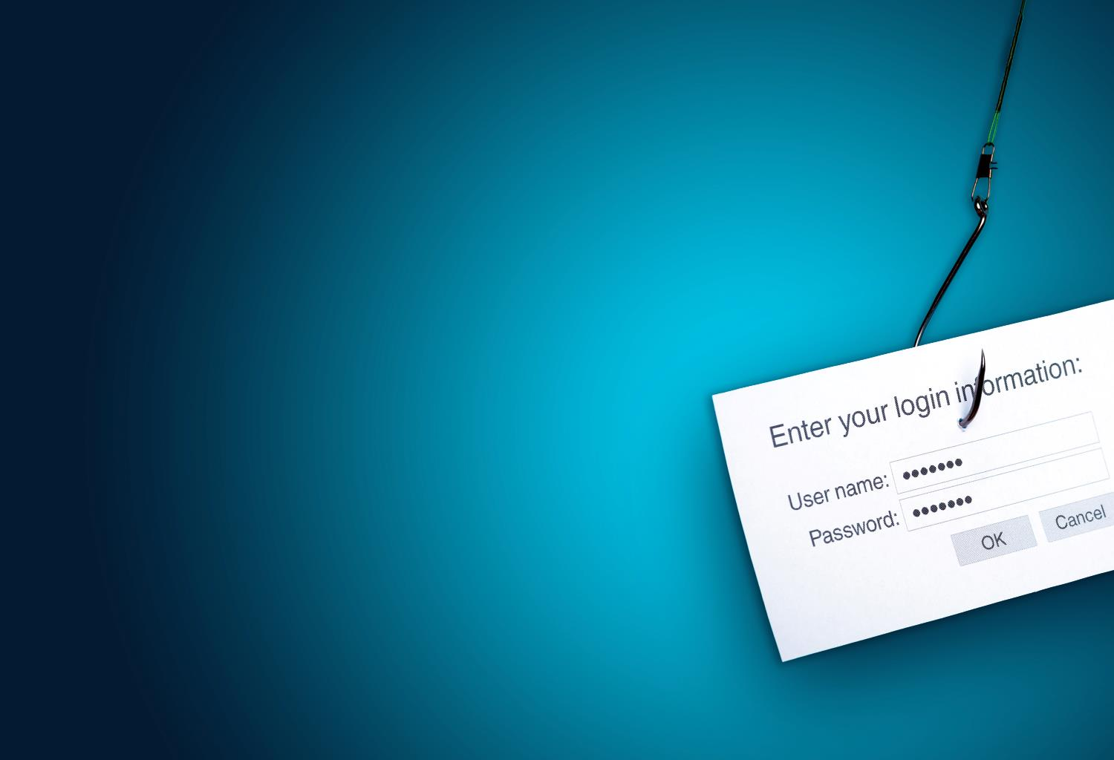
Phishing
Phishing is a type of social engineering technique
Emails, texts or phone calls are sent to users commonly pretending to be from a bank or website
The ‘From’ email address may be forged
These messages will try to get personal information such as:
Usernames
Passwords
Credit cards details
Other personal information

Slide 16
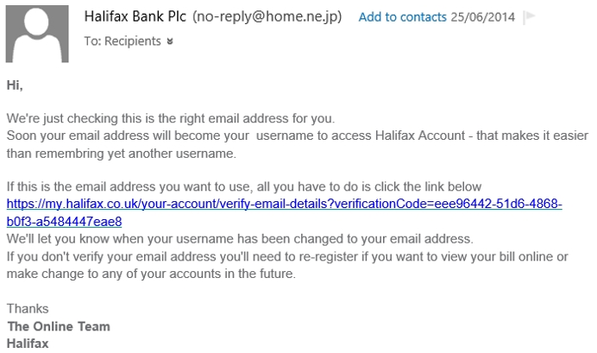
A typical phishing email

Slide 17
What to look out for
Greeting: The phishers don’t know your name – just your email address, so the greeting is not personalised
The sender’s address is often a variation on a genuine address
Forged link: The link looks genuine, but it the URL attached to it may not link to the website given. Roll your mouse over it to check
Request for personal information: Genuine organisations never do this
Sense of urgency: Criminals try to persuade you that something bad will happen if you don’t act fast
Poor spelling, grammar and tone

Slide 18
Pharming
Pharming is a term made from the two words:
Phishing and Farming
A users computer or a DNS server are altered so that they match a domain name to an incorrect IP address
When the browser searches for a web page, it will go to the wrong IP address which is controlled by a hacker
The hacker will have a web server that serves a fake web page, such as a form for a user to log in to a bank

Slide 19
Worksheet 5
Now complete Task 2, Task 3 and Task 4 on Worksheet 5

Slide 20
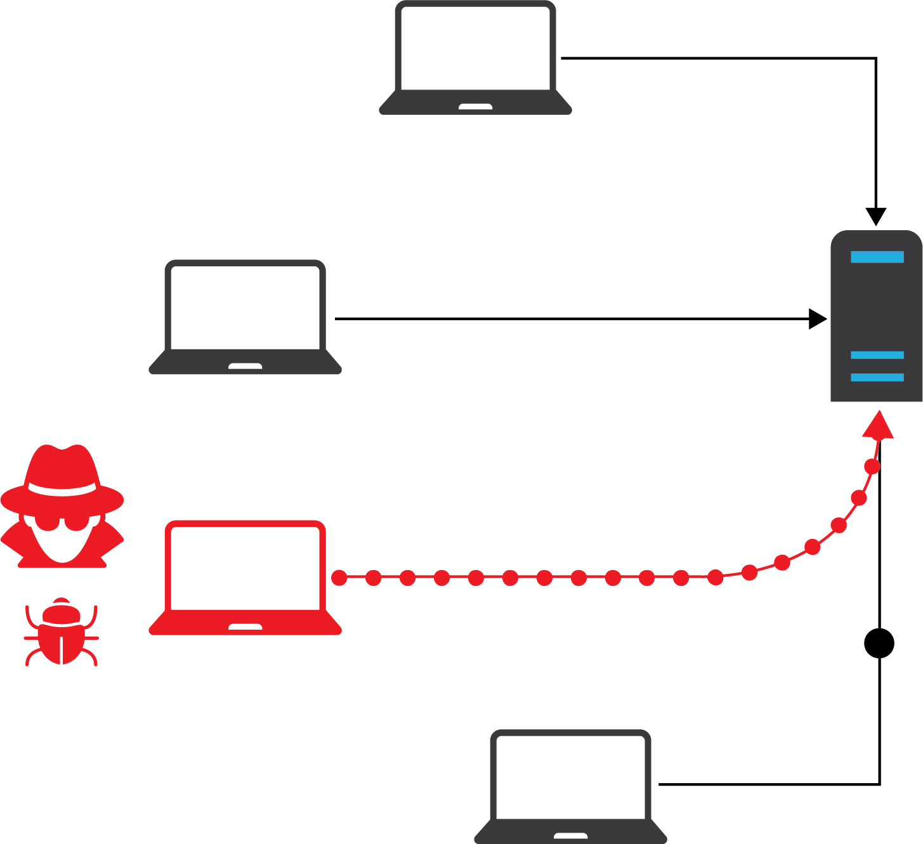
Denial of Service (DoS)
In a denial of service attack, a hacker will use or infect a computer so that:
it sends as many requests to the server as it can (known as a flood)
the server can’t respond fast enough so slows down or goes offline
In a distributed denial of service attack (DDoS), many computers are used to send the requests

Slide 21
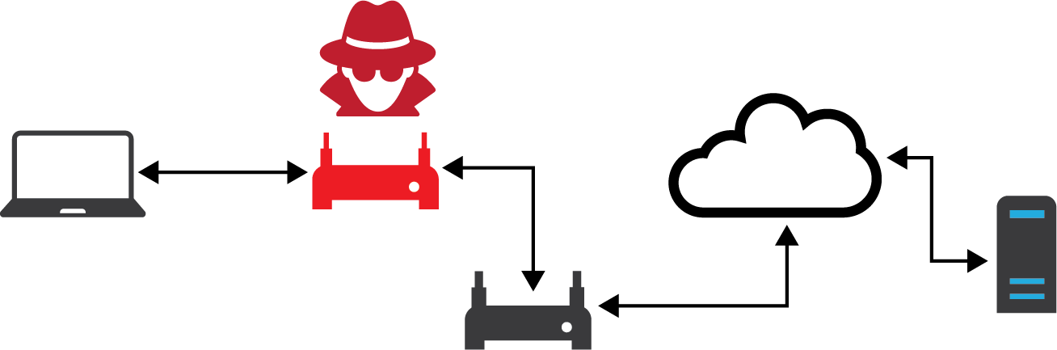
Man-in-the-middle attack
A man-in-the-middle attack (MITM) allows the attacker to intercept data communications between the user and server. The attacker can then:
eavesdrop to find passwords and personal information
add different information to a web page or other communication such as email
Connecting to unencrypted Wi-Fi makes it easy to perform a MITM attack

Slide 22

Found – a free USB stick!
Criminals sometimes leave a USB stick containing malware in a public place such as a company car park
An unsuspecting employee may pick it up and insert it into their computer
The malware can now install onto the computer so that a hacker can gain access to files, personal data and system resources

Slide 23
Data theft
In 2014, the details of 125,000 students of Staffordshire University were stolen from a laptop left in a car
Data included the address, telephone number and email addresses for university applicants since 2006
Where could this information end up?
How could it be used?

Slide 24
Threats from digital devices
Digital devices are often targeted by criminals
Loss of a mobile phone can lead to the loss of all the data stored on it, including passwords, account numbers and credit card details
Malware which targets digital devices may create ‘back doors’ to give malicious users access to your device
Many apparently legitimate apps are malicious and may lead to fraudulent charges on your phone bill or theft of personal information
How can these risks be reduced on a mobile phone?

Slide 25
Protect your mobile phone
Reducing threats on mobile devices
Use the password feature and choose a strong password
Make sure the data is encrypted
Do not follow links in suspicious emails
Think carefully before posting your mobile phone number on public websites
Don’t install apps without researching them first – if they require unnecessary extra permissions, don’t install them
Delete all information stored on your mobile before discarding

Slide 26
Brute force attacks
In a brute force attack, a hacker will try every combination of password until the correct password is found
A computer program is usually used to do this as it can try millions of passwords per second
Password attempt | Outcome
0001 | Incorrect password
0002 | Incorrect password
0003 | Incorrect password
0004 | Incorrect password
0005 | Password found

Slide 27
Worksheet 5
Now complete Task 5 on Worksheet 5

Slide 28

Plenary
In a pair, come up with one accurate sentence to describe each of the following forms of attack:
Brute-force attack
Data interception
Distributed denial of service (DDoS) attack
Hacking
Malware
Pharming
Phishing
Social engineering

Slide 29
Plenary
Brute-force attack – trying all possible passwords until the correct one is found
Data interception – obtaining data, without permission, passing through a network
Distributed denial of service (DDoS) attack – flooding a server or network with pointless requests to make it fail or slow down
Hacking – Activities that misuse computer systems/networks
Malware – software that aims to harm computers and/or data
Pharming – Changing DNS records to point to the wrong IP address
Phishing - emails that pretend to be form legitimate companies but actually try to gain personal information
Social engineering – Obtaining confidential information by asking for it - usually making use of confidence tricks

